Slide 1



ROLLCALL MarKEr
Problem Statement Title : An app that makes the process of marking the attendance hassle free through QR .
Theme Name: ROLLCALL MARKER
1

Slide 2

SOLUTION
After analyzing all aspects we came up with a solution of automating attendance system by implementing QR based attendance system.
This would change the traditional method of manually recording attendance by calling names into fully automated and efﬁcient system.
RollCall Marker contains three interfaces one for faculty,another for student and one for admin.
The faculty interface lets professor to create a session according to subject code and section of current class.
On the other hand the student interface after successful login creates a QR that is unique for every SAP ID.
When the scanner in the faculty interface scans QR of students ,it accordingly marks attendance in database of the particular day.
The students now are able to mark their attendance all by themselves which saves a hefty amount of time ,is easy to operate and saves wastage of resources.
Also for the purpose of preventing proxys, our app doesn’t allow taking screenshot of the QR code page.
3

Slide 3



TIMELINE
Implementing security features like making the QR generation dynamic in app with a safe environment to reduce proxys
In this stage we would give major improvement of handing the QR scanning part to a cheap emmbeded board Node Mcu so that teacher wouldn’t have to put its mobile on wall .
Wrapping up initial app with simple qr based attendance.with services like create session , view attendance,
Setting up student and faculty database then creating student and faculty login
Implementing the system in the classrooms.
1st Stage
2nd Stage
3rd Stage
4^{t} Stage
5th Stage
6th Stage
7th Stage
8th Stage
9th Stage
Adding QR scanning service to faculty’s section and QR generation service in student’s section
Implementing NodeMcu chip for buzzer/beep on check out / in.
Setting up absentees email Introducing security features
messaging.
in latest embedded chip system.
7

Slide 4
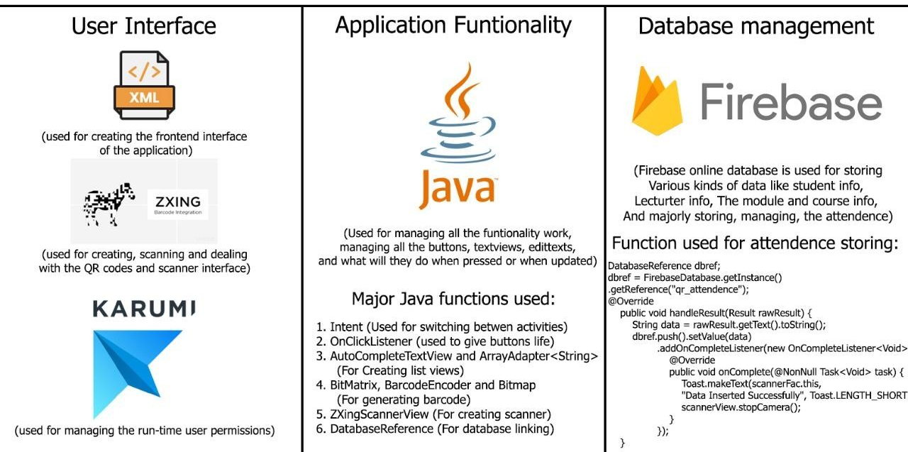


Slide 5
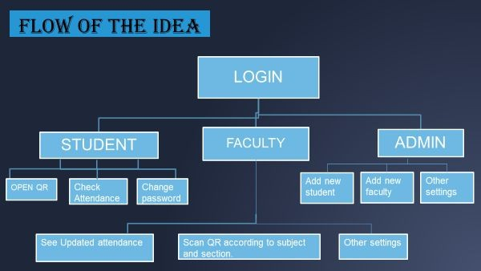


Slide 6

HOW WILL WE IMPLEMENT IT?
Mobile App
We are using Firebase for storing data in database on cloud.
The mobile app would recognise credentials and open the student
,teacher,admin interface accordingly.
The Mobile App is based on Java with XML as frontend designing tool.
The student interface has open Qr functionality and teacher interface has create session to scan QR according to subject and section as the key to select table from database.
App also has other functions like show attendance ,change password ,etc.
Working
The teacher on the beginning of class would create session with subject code and section. This would create ﬁle for the current session with credentials and also time associated with it.
After which App starts scanning QR and for every valid QR scanned the App would mark attendance of the linked SAP ID in the ﬁle for the session.
For student interface students can open their app and can click on generate QR .
This will generate a QR that will be unique for each SAP ID and would act as the primary key for selecting required record from table in database.
6

Slide 7
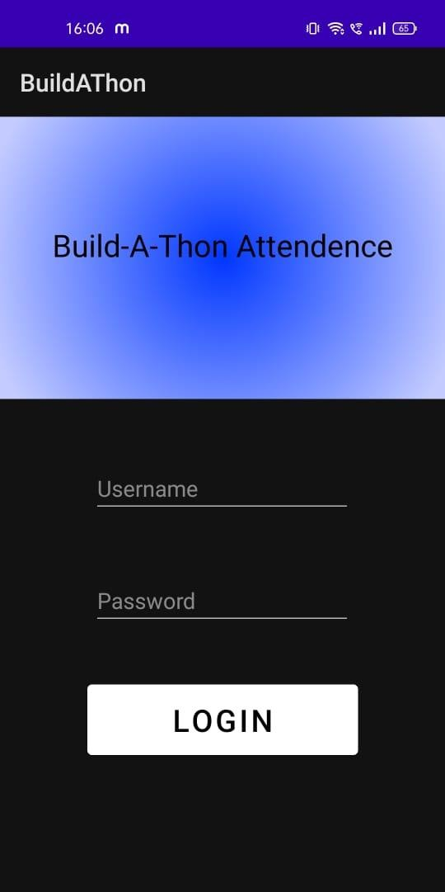
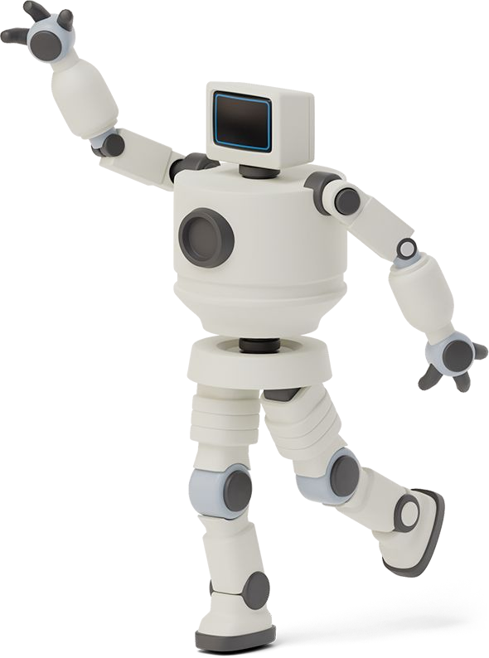



WHAT OUR APP LOOKS LIKE? (AS OF NOW)
The android app is the main part of the project. Till now, we have come up with some basic UI that shows three tabs of logging in as student,faculty or admin . As soon as we enter the correct login credentials as per saved in the admin system we go into respective interface.
App is in its build phase and soon it would be ready for use.

Slide 8
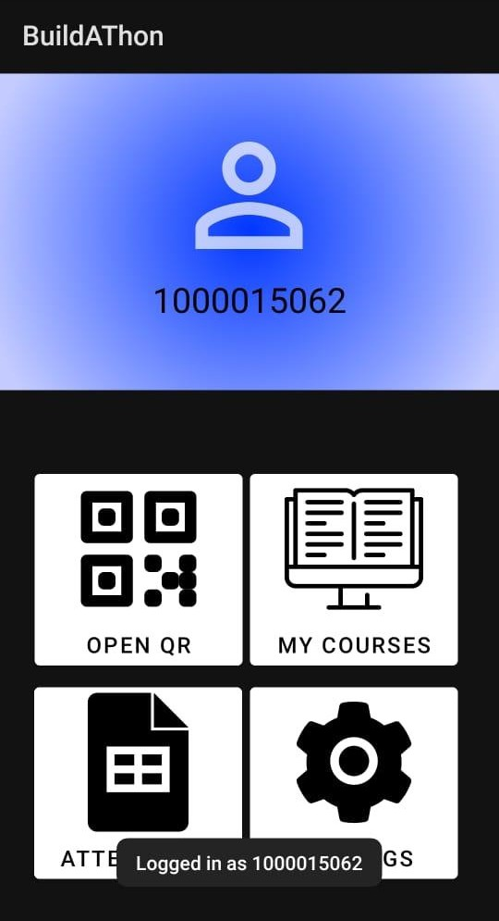


WHAT STUDENT INTERFACE LOOKS LIKE? (AS OF NOW)
As soon as we enter the correct login credentials as per saved in the admin system we go into student interface where we see options to generate QR and check attendance along with other settings like password changing.

Slide 9
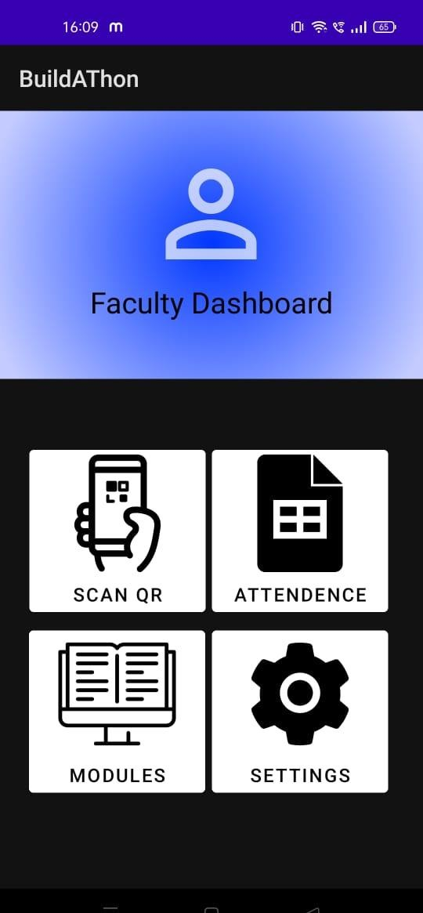

WHAT FACULTY INTERFACE LOOKS LIKE? (AS OF NOW)
As soon as we enter the correct login credentials as per saved in the admin system we go into faculty interface where we see options to scan QR and check attendance along with other settings like password changing.

Slide 10
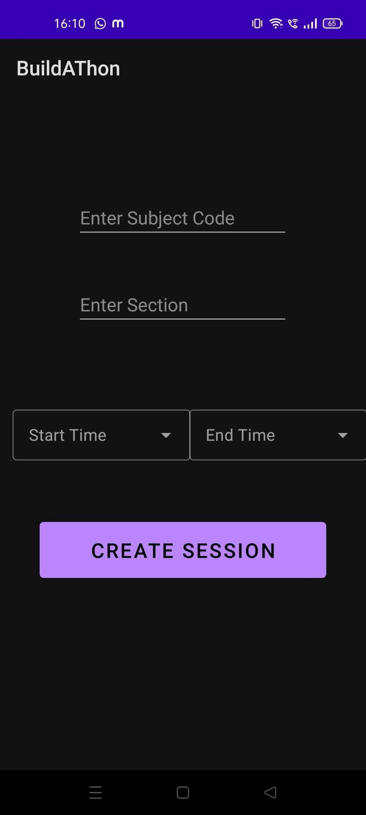

WHAT FACULTY INTERFACE LOOKS LIKE? (AS OF NOW)
Also clicking on scan QR takes us to a page which opens scanner as per the particular class that the attendance is being marked for after clicking on create session.
Then accordingly the scanner scans and at the backend marks the attendance.

Slide 11
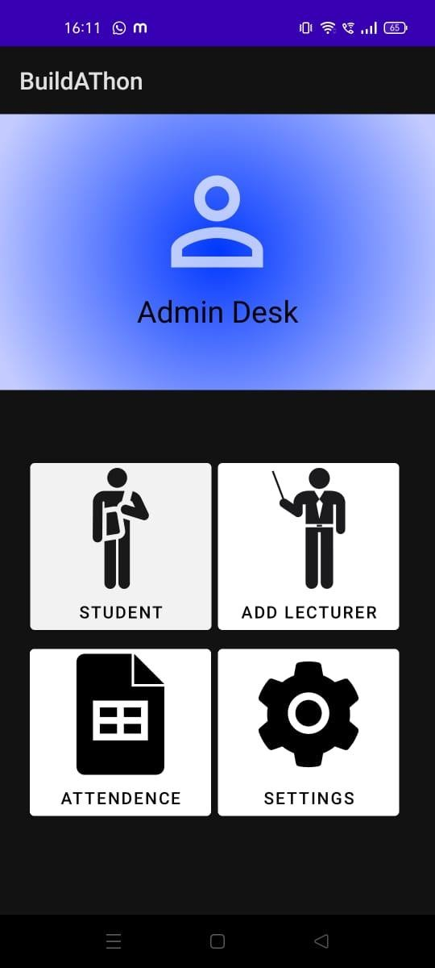

WHAT ADMIN INTERFACE LOOKS LIKE? (AS OF NOW)
As soon as we enter the correct login credentials as per saved in the admin system we go into admin interface where we see options to add new student, faculty and check attendance along with other settings like password changing .etc.

Slide 12
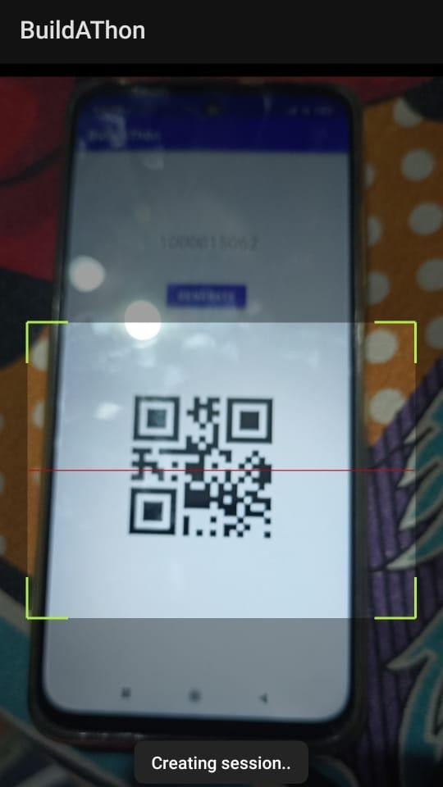
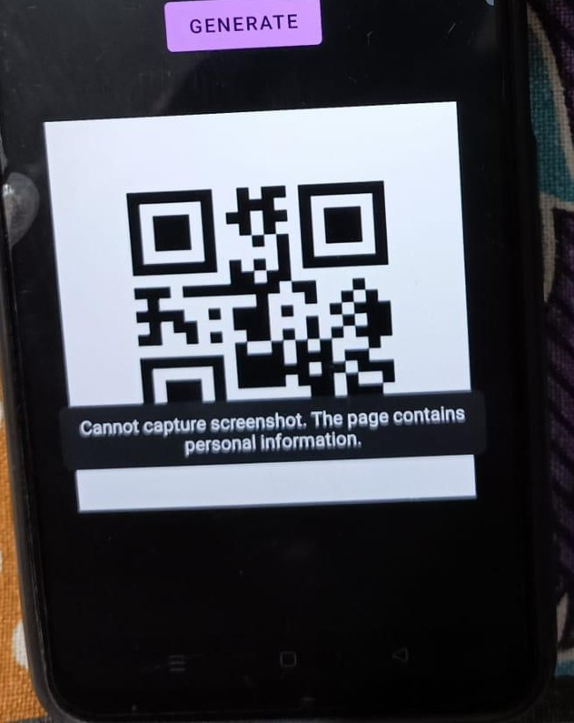

WHAT APP LOOKS LIKE? (AS OF NOW)
Preventing screenshot of the QR code
Scanning
13

Slide 13


Major Problems Faced
While working in a team at far places coming up to a single Ui design was tough.
Thinking of a ways of making our app safer to prevent proxys was hard. Preventing taking of screenshot and one device one login is what we have come up till now.
Linking the QR code to SAP and further linking it to mark the attendance in database was one of the task that really took all our sweat.
Different team members knew different languages such as java,flutter,etc . Working together on one language was hard.
While using the additional dependency while integrating it sometimes is not compatible with the AndroidSDK version, that case we have to try all the recent or older version of the module and then rebuild the application again so that it is compatible with the SDK version.
Creating so many buttons , activities, variables even after naming them according to their functionality, sometimes made it confusing and the whole app would crash just because of the use of wrong variables.
14

Slide 14


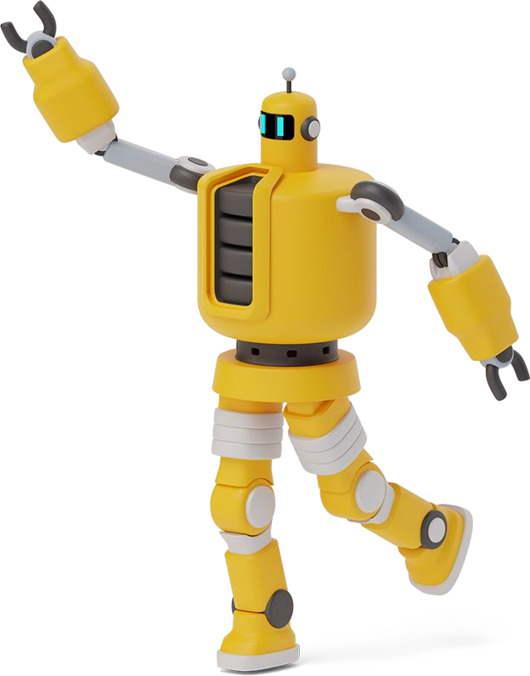
WhaT MaKEs OUr app sTaNDOUT FrOM OThErs
There are already existing models available on play store like attendance tracker, mark me present ,etc.
Such apps have 10k+ downloads on playstore .The success of these apps show need of such ideation of marking attendance which saves time.
Our app is not only just a manager of attendance with methods such as biometric, but uses the idea of QR which makes it different from other apps.
RollCall Marker makes the process of marking attendance not only time saving but hassle free and user friendly.
It’s basic interface makes it easier for any type of student and faculty to handle.
With just some clicks the attendance of all the students will be marked within 5 minutes for however large the class maybe.
One such feature of app that makes it different from others is the inability of the user to take screenshot of the QR thus preventing marking of fake attendances through friends.
14

